Slide 1


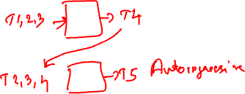
Introduction to Neural Networks
ACP in AI&MLOps Cohort 4
Deepak Subramani
Assistant Professor
Dept. of Computational and Data Science
Indian Institute of Science Bengaluru

Slide 2
Learning Objectives
What is a neural network?
What are neurons, layers, models?
What are parameters and hyperparameters?
What is a loss function?
What is an iteration, batch, epoch?

Slide 3
Quiz
What will you use for questions?
Chat
QA

Slide 4
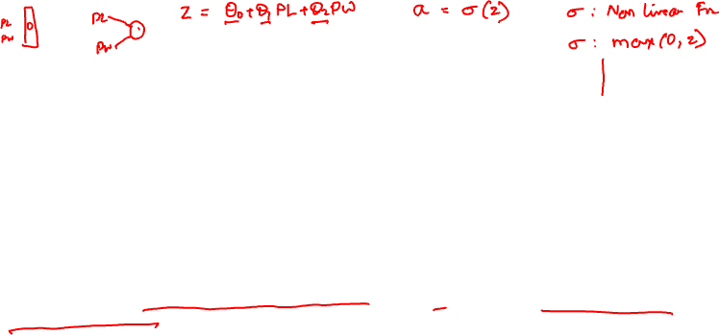
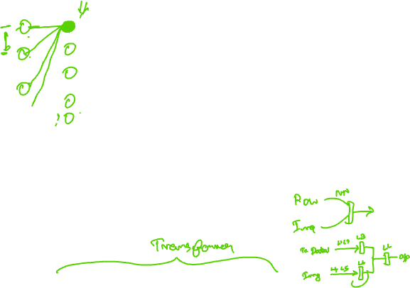
Neural Network
Data (Single or multiple modalities)
Row of a table
Image
Document
Sequence of row (time series data)
Sequence of image (video)
Sequence of audio signal
Output (Predictive AI)
Multi-Class Classification
Multi variate regression
Time Series
Output (Generative AI)
Image, Text, Video, Audio
Layer 1
Layer 2
Layer n-1
Each Layer Consists of Neurons
Neurons have a linear combination of input, followed by application of nonlinear activation function. Have parameters (weights and bias)
Several Neurons form a layer
Several Layers form a network
Input has data
Output layer depends on task
Important Layers: Dense, Convolution, Multi-Head Attention, Masked MHA

Slide 5
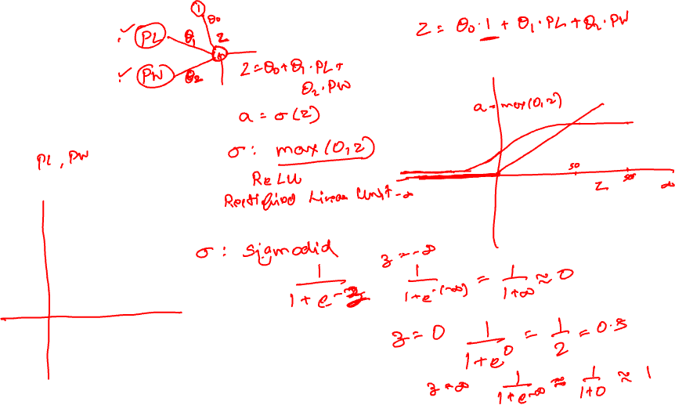

Slide 6
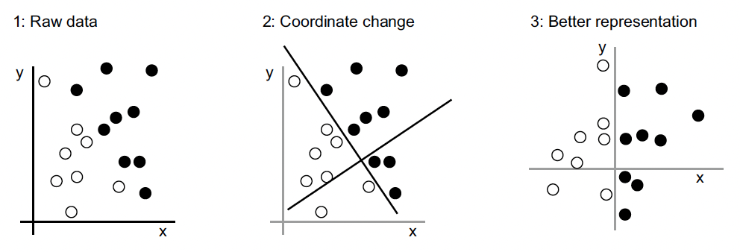
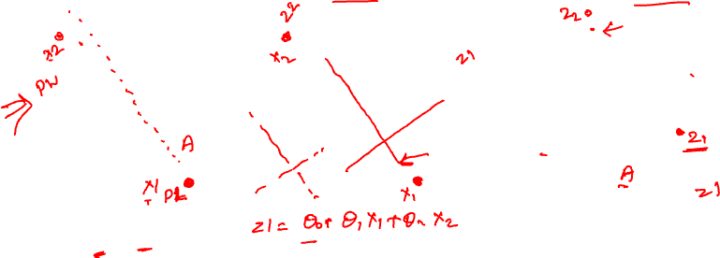
Efficient Representation of Data
x1
z1
a1
x2
z2
a2

Slide 7
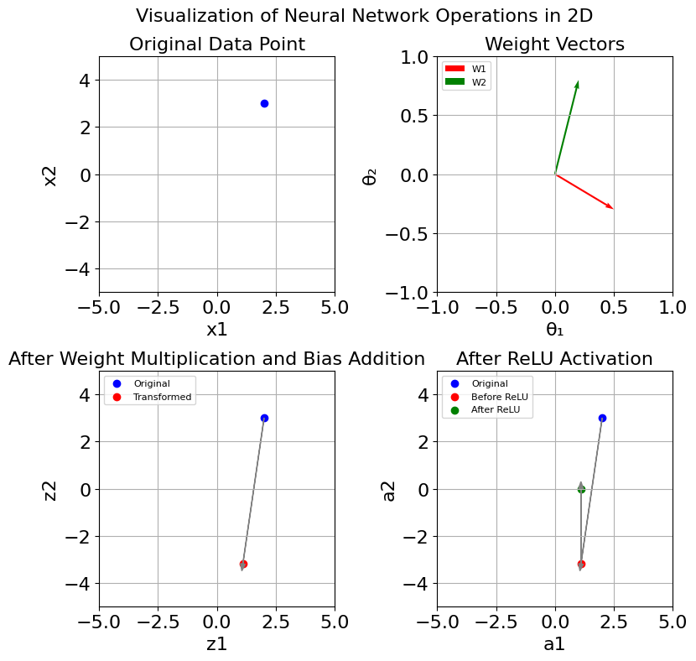
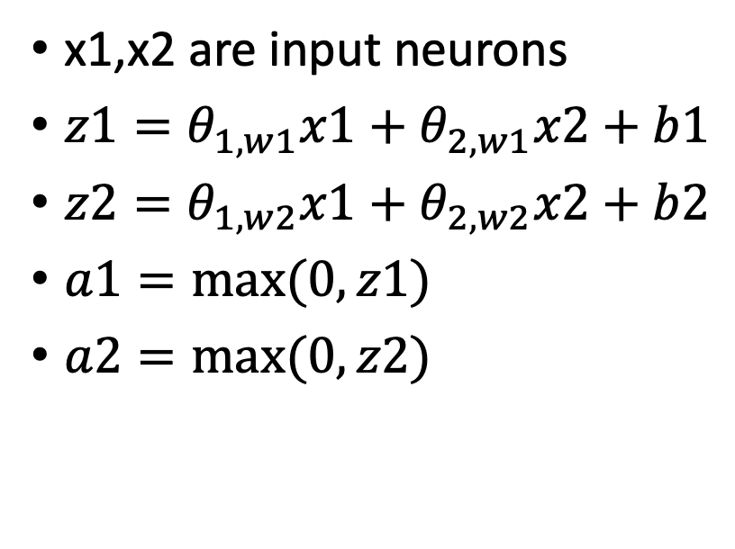
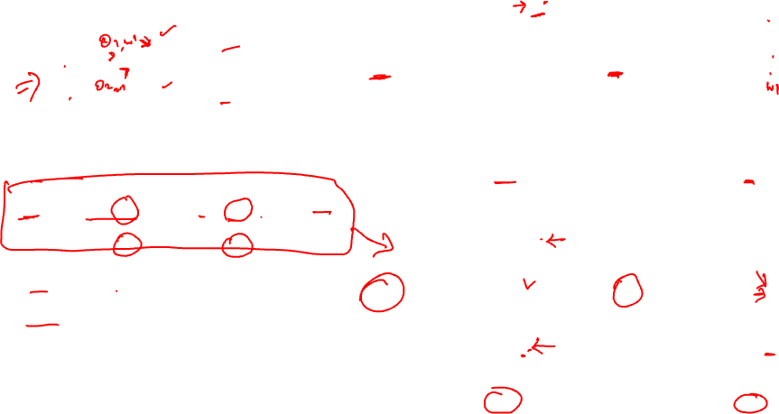
Operations in a neural network
x1
z1
a1
x2
z2
a2
x1,x2 are input neurons
$z1=θ_{1,w1}x1+θ_{2,w1}x2+b1$
$z2=θ_{1,w2}x1+θ_{2,w2}x2+b2$
$a1=max⁡(0,z1)$
$a2=max⁡(0,z2)$

Slide 8
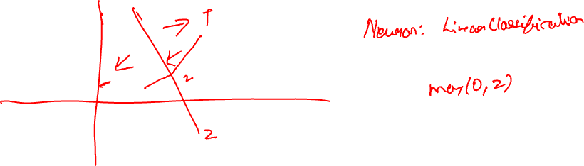
What is a Neuron?
Computational Unit, Data Processing Unit
It does two activities
Take a weighted linear combination of input, add a bias
Apply an activation function on the result

Slide 9
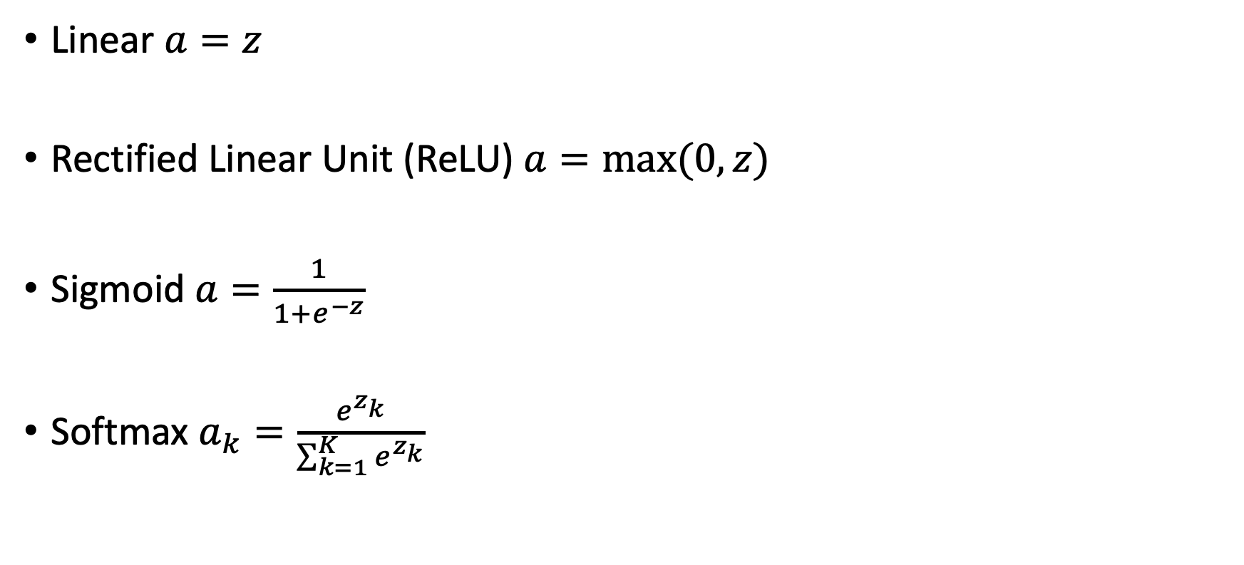
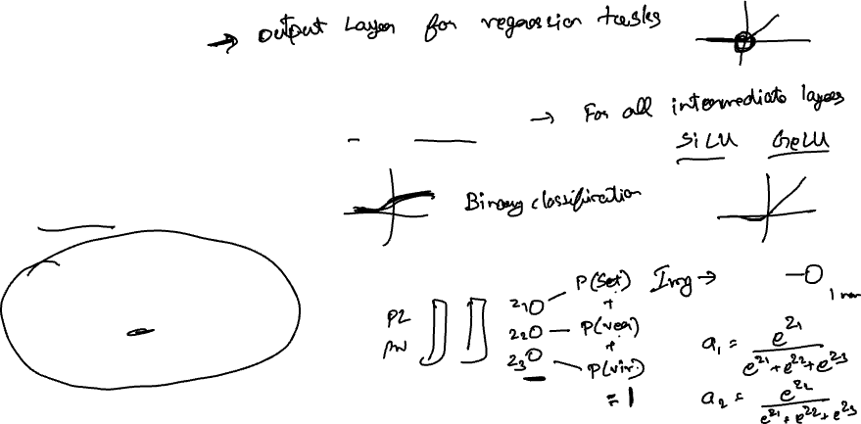
Activation Functions
Linear $a=z$
Rectified Linear Unit (ReLU) $a=max⁡(0,z)$
Sigmoid $a=\frac{1}{1+e^{−z}}$
Softmax $a_{k}=\frac{e^{z_{k}}}{\sum_{k=1}^{K}{e^{z_{k}}}}$

Slide 10

Visualizing the action of a neural network
Neural layers transform the data to different representations
The transformations are effected through weights and biases
These weights and biases are learnt from data during training
The learnt representation make the downstream task easier
Prior to deep neural networks, these representations were hand crafted using a mechanism called as feature engineering (from domain knowledge)
Layers of a neural model unflods the crumbled paper ball (data in complex manifolds) to an unfolded paper (simple representation)

Slide 11
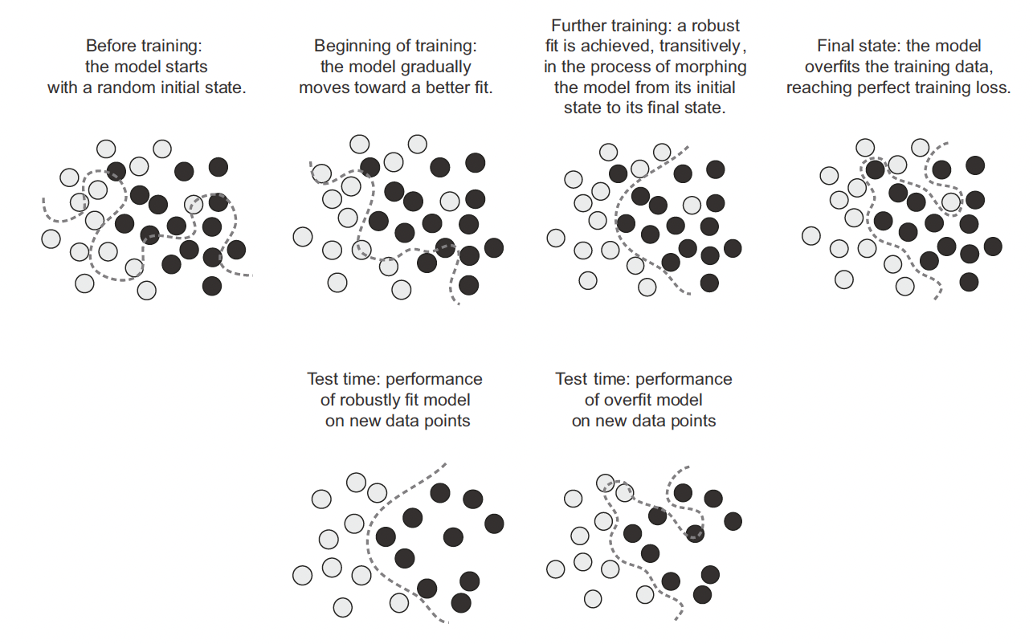
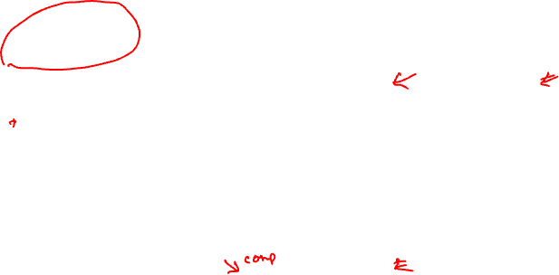
Decision Boundaries with Training

Slide 12
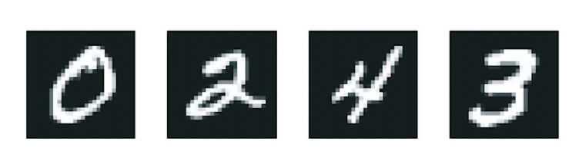
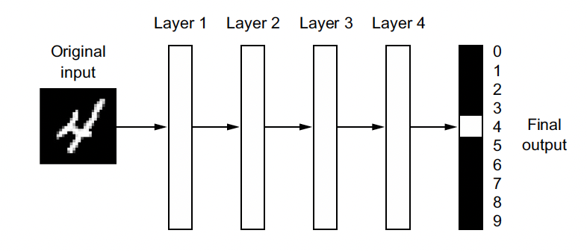
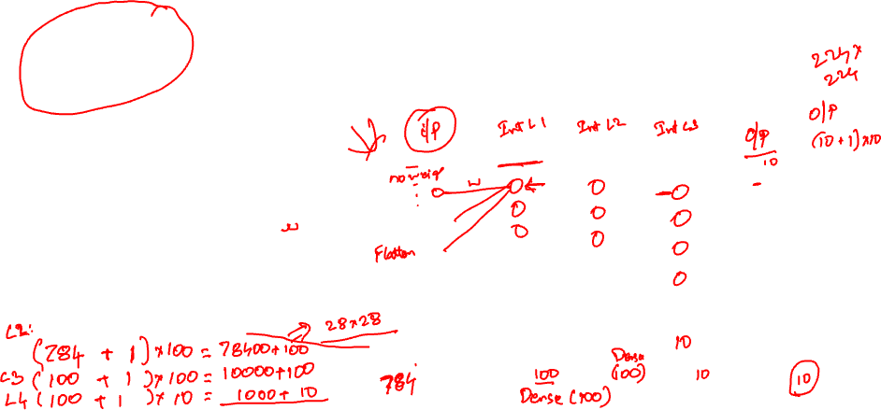
Neural Network for Classification
2D image is flattened to a vector
Vector is passed through layers
Final output layer has 10 neurons corresponding to 10 class classification
MNIST Hand Written Digit Recognition

Slide 13
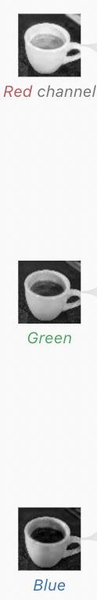
Neuron Arrangement in Dense Layer
48*8+8=392 parameters
Reshape to 2x2
Flatten and Stack Together 16*3=48 Neurons
Dense Layer with 8 Neurons

Slide 14
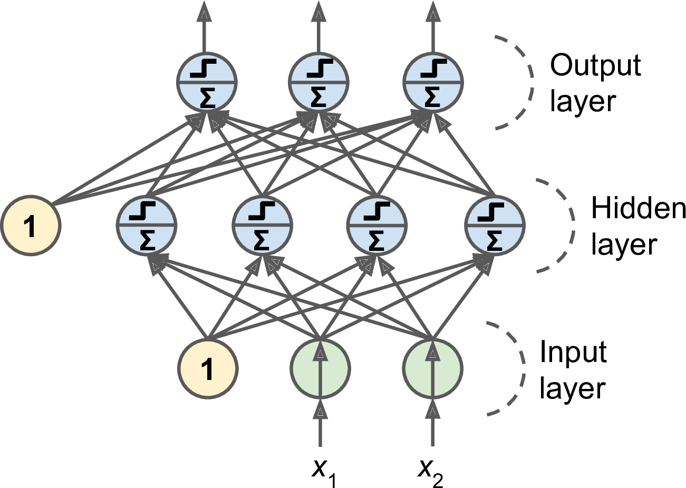
Dense Neural Network
Input layer is a passthrough layer
Hidden layers are composed of neurons
Output layer returns
a number (as many neurons as quantities of interest) for regression tasks and
probability of a class for classification tasks (as many neurons as number of classes)
Layers closer to the input are called as lower layers
Layers closer to the output are called as upper layers
Here the signal only flows in one direction, so this architecture is called as a feedforward neural network (FNN)

Slide 15
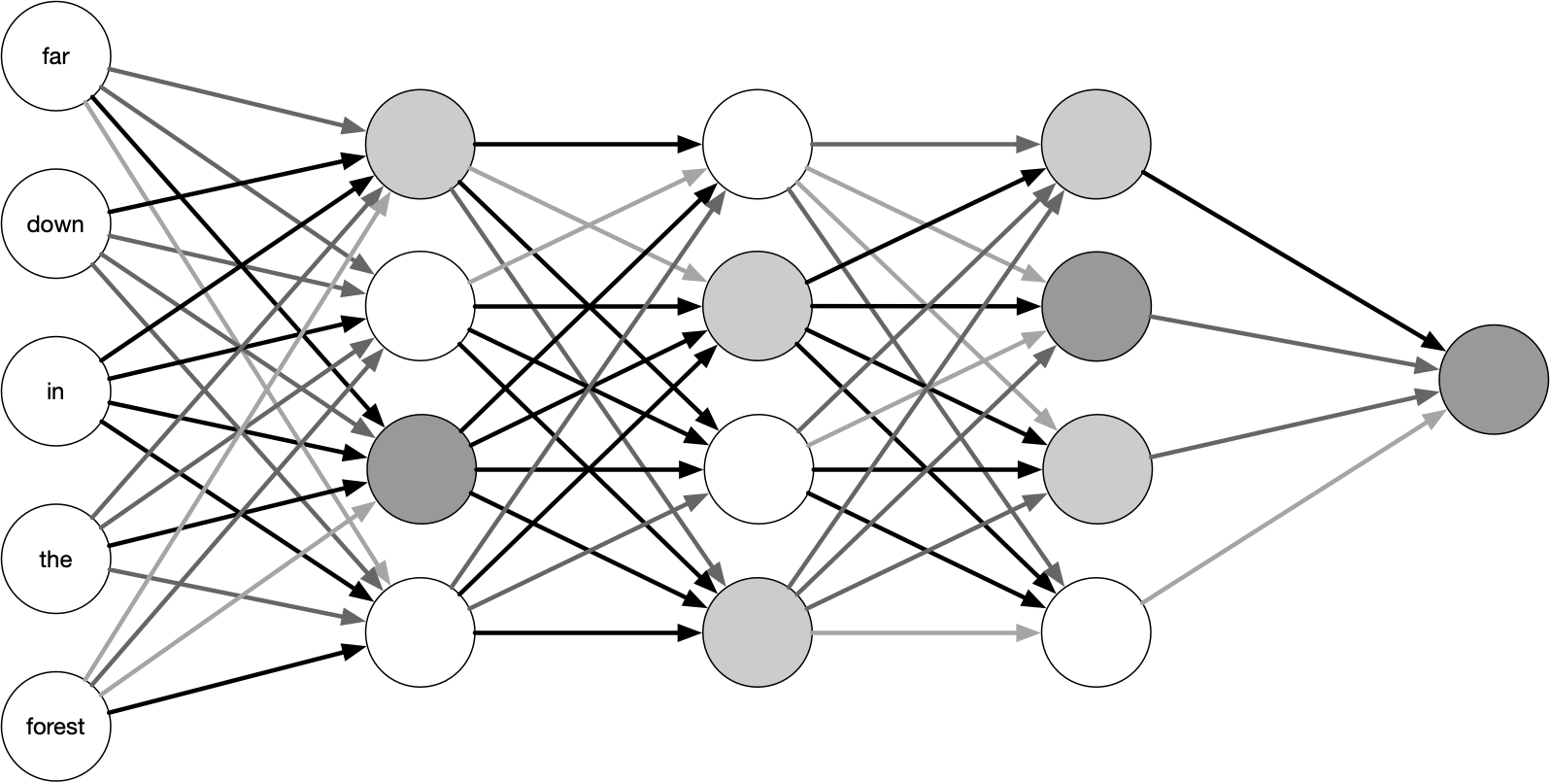
Calculating Size of a Dense Neural Network
4x5+4=24
4x4+4=20
4x4+4=20
1x4+1=5

Slide 16
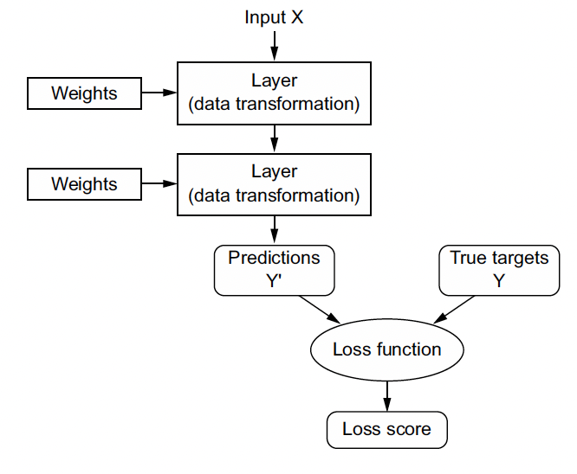
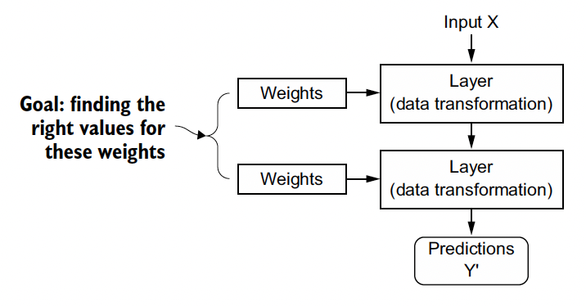
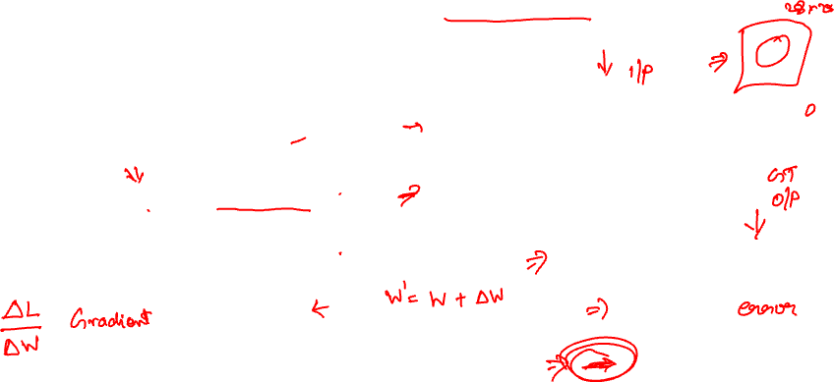
Training the Neural Network
Ground truth supervision data gives us the loss
Goal of training is to find parameters (Weights and bias of every neuron)

Slide 17
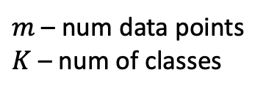
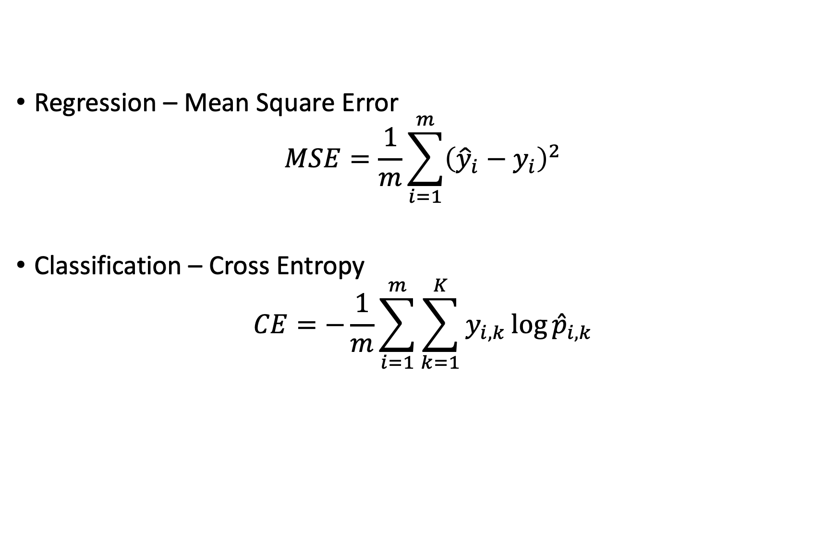
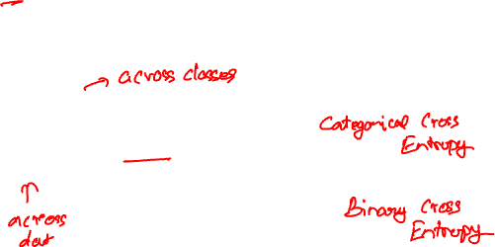
Loss Function
Regression – Mean Square Error
$$MSE=\frac{1}{m}\sum_{i=1}^{m}{{\left({\hat{y}}_{i}−y_{i}\right)}^{2}}$$
Classification – Cross Entropy
$$CE=−\frac{1}{m}\sum_{i=1}^{m}{\sum_{k=1}^{K}{y_{i,k}\log{{\hat{p}}_{i,k}}}}$$
$m$ – num data points
$K$ – num of classes

Slide 18
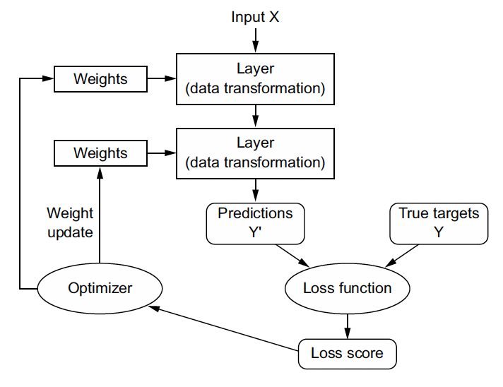
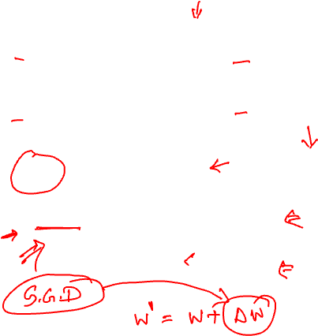
Training the Neural Network
An optimizer adjusts the weights (and bias) in such a way that the loss function reduces
The process of finding these weights (and bias) is called training
A training algorithm called Stochastic Gradient Descent (variant called ADAM) is used for the training

Slide 19
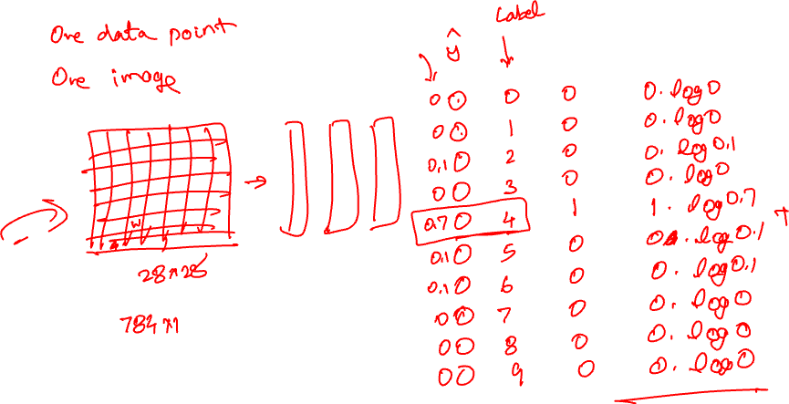

Slide 20
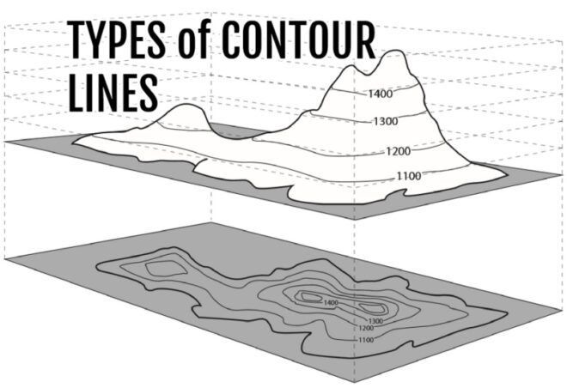
Gradient Descent: Figure Explanation

Slide 21
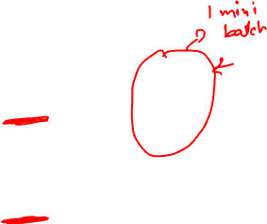
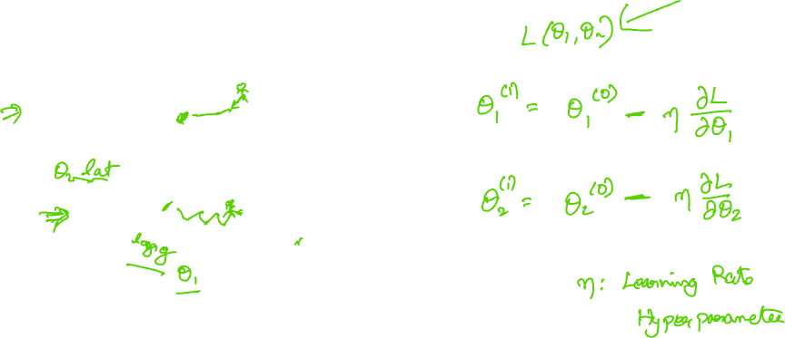
Gradient Descent: Figure Explanation

Slide 22
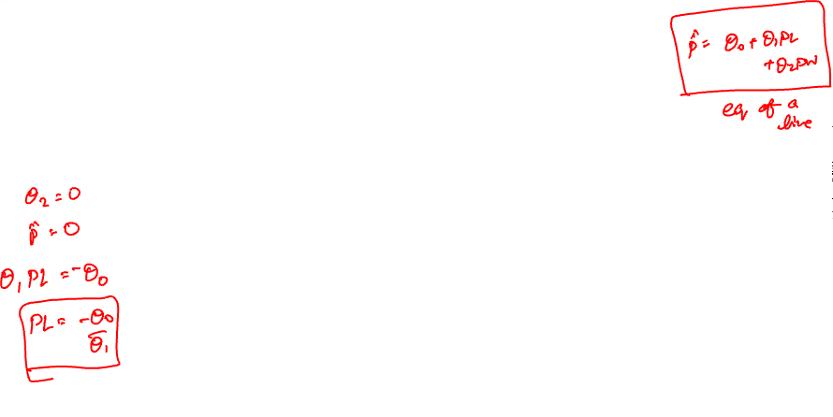
Gradient Descent: Figure Explanation

Slide 23
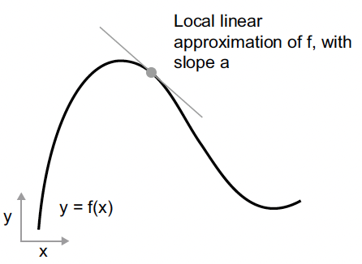
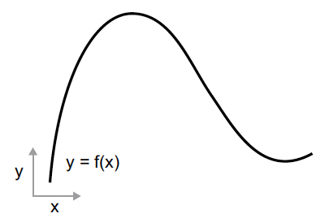
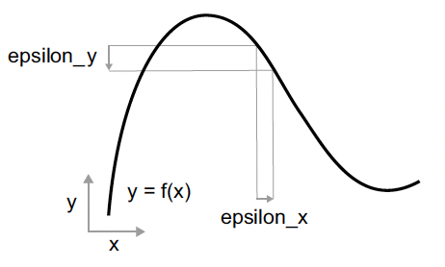
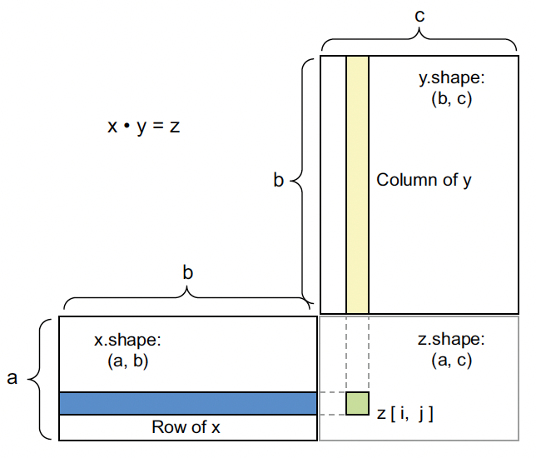
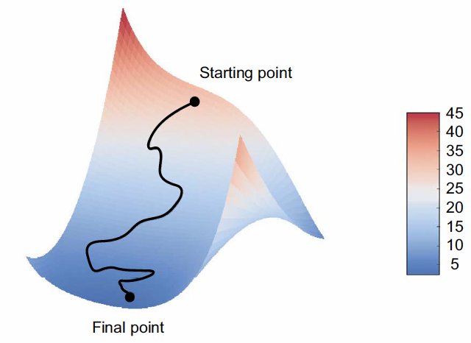
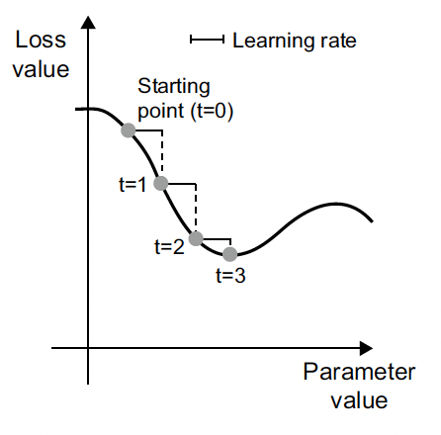
Math through figures

Slide 24
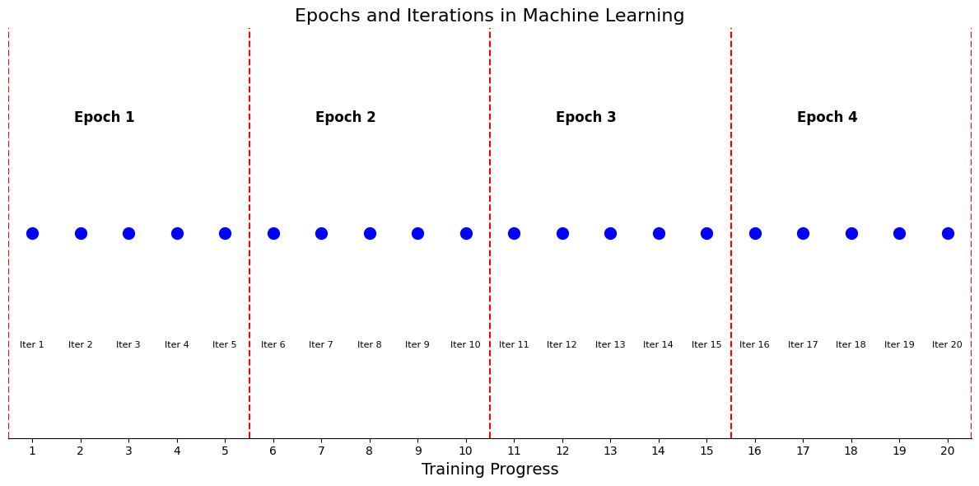
Iteration, Batch, Epoch
Data Set = 1000 samples
Batch Size = 200
One iteration uses 200 data points to calculate loss and derivative of the loss with respect to all params
5 iterations comprise one epoch
In this example 4 epochs are shown
In each epoch all the parameters are updated 5 times (in this example)
Epoch 2 starts with Iter 6
It updates the parameters at the end of Iter 5 (Epoch 1)

Slide 25
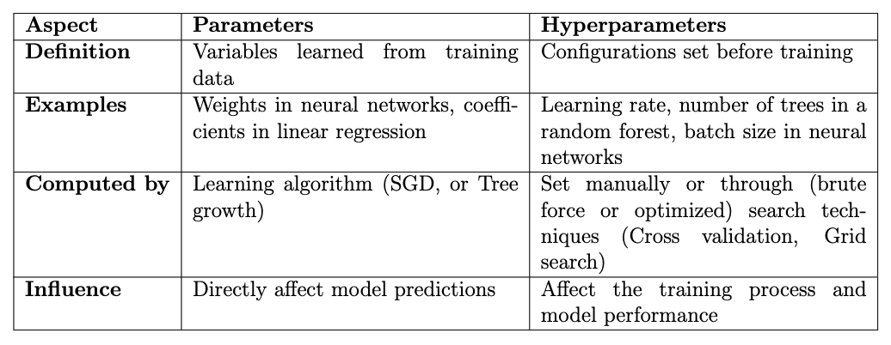
Parameters and Hyperparameters

Slide 26
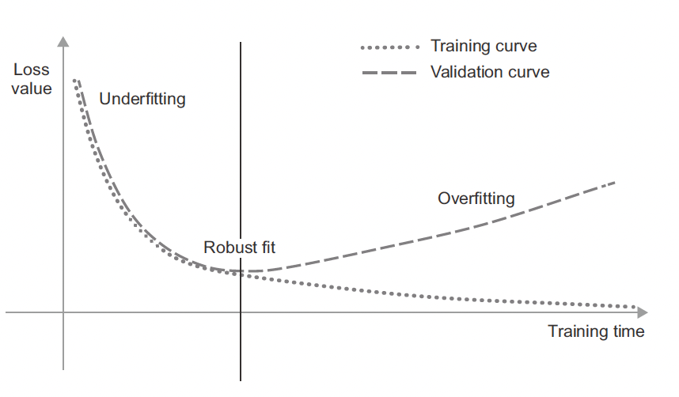
When to stop? - Training and Validation Error

Slide 27
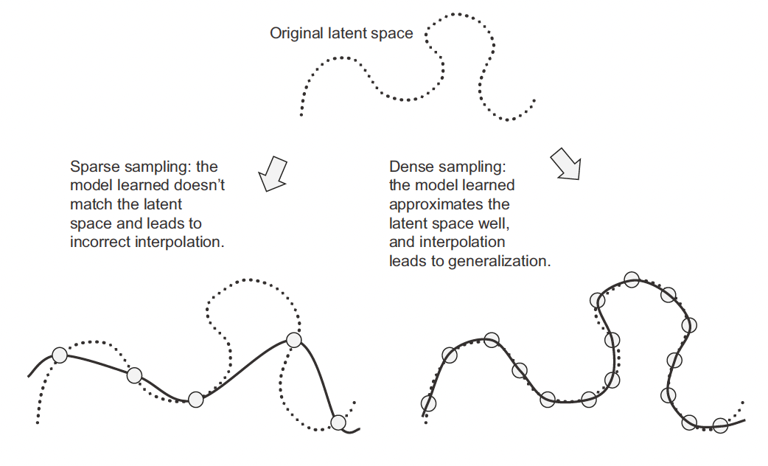
How much data is needed?

Slide 28
Regularization to avoid overfitting
Capacity of a neural network is its tendency to overfit
More the number of parameters, the more its capacity (a.k.a degrees of freedom)
Regularization in a neural network is a mathematical trick to penalize the neural network such that it reduces the capacity to overfit
Typically norm-based regularization in which a penalty term (consisting of the parameters) is added to the loss
Sometimes drop-out regularization in performed
Batch normalization, layer normalization and early stopping all act as regularization

Slide 29
Tensorflow Playground
https://playground.tensorflow.org/
Exercises:
Understand patterns learned by the neural network
Understand different activation functions
What is the time to solution, how are the decision boundaries
Local minima for small networks. Have only one hidden layer with three neurons
Underfitting. One hidden layer with two neurons
One layer with 8 neurons. Train multiple times. Network hardly gets stuck. Lesson: Large networks seldom get stuck in local minima, and even if they do, it is close to the global minima
Vary other parameters and learn.

Slide 30
Week 03
Additional Material: Advanced gradient descent algorithms, Initialization, Stopping

Slide 31
Faster Optimizers
Deepak Subramani
Assistant Professor
Dept. of Computational and Data Science
Indian Institute of Science Bengaluru

Slide 32
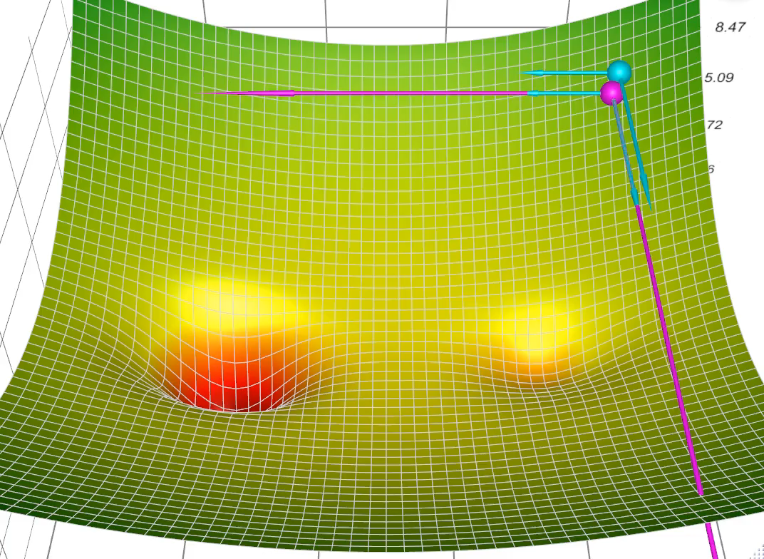
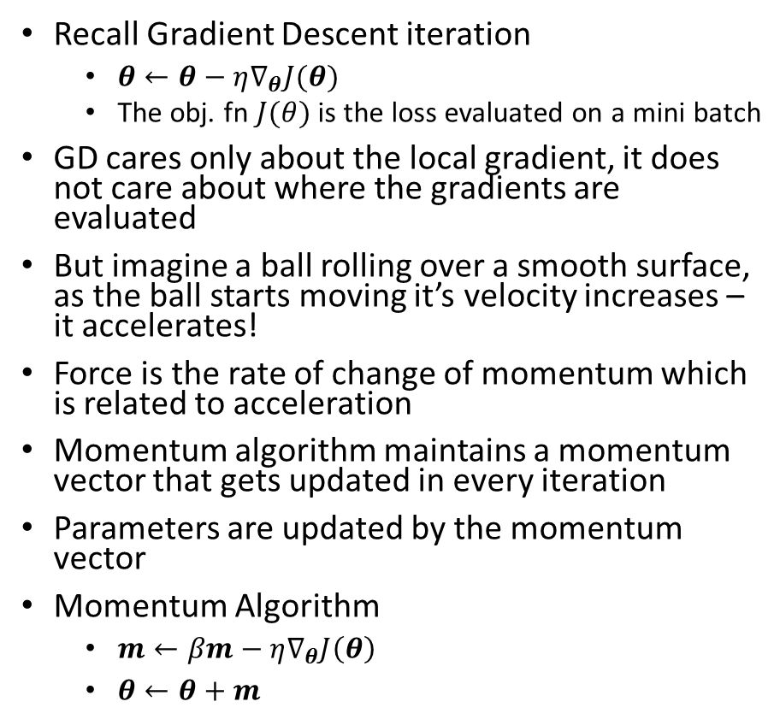
Momentum optimization
Recall Gradient Descent iteration
$θ←θ−η∇_{θ}J(θ)$
The obj. fn $J(θ)$ is the loss evaluated on a mini batch
GD cares only about the local gradient, it does not care about where the gradients are evaluated
But imagine a ball rolling over a smooth surface, as the ball starts moving it’s velocity increases – it accelerates!
Force is the rate of change of momentum which is related to acceleration
Momentum algorithm maintains a momentum vector that gets updated in every iteration
Parameters are updated by the momentum vector
Momentum Algorithm
$m←βm−η∇_{θ}J\left(θ\right)$
$θ←θ+m$
Blue Ball – GD
Purple Ball – Momentum Optimization
Blue vectors – gradients
Purple Vectors – Momentum
Simulator: https://github.com/lilipads/gradient_descent_viz

Slide 33
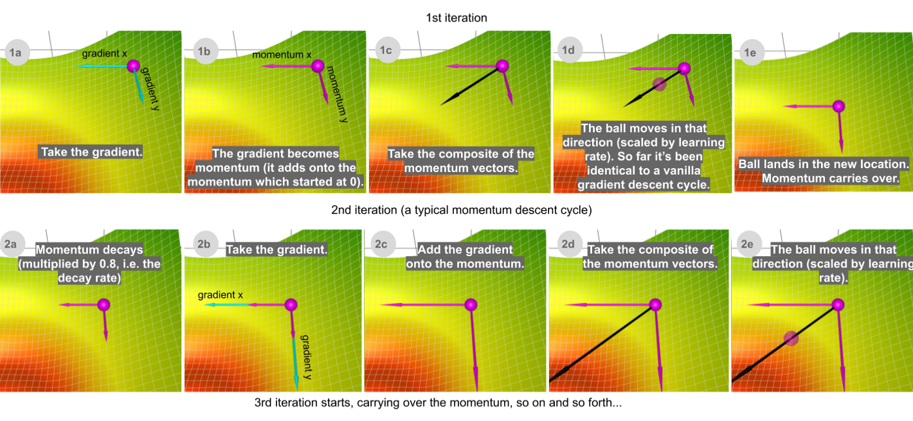
Momentum Step-By-Step
Source: https://towardsdatascience.com/a-visual-explanation-of-gradient-descent-methods-momentum-adagrad-rmsprop-adam-f898b102325c

Slide 34
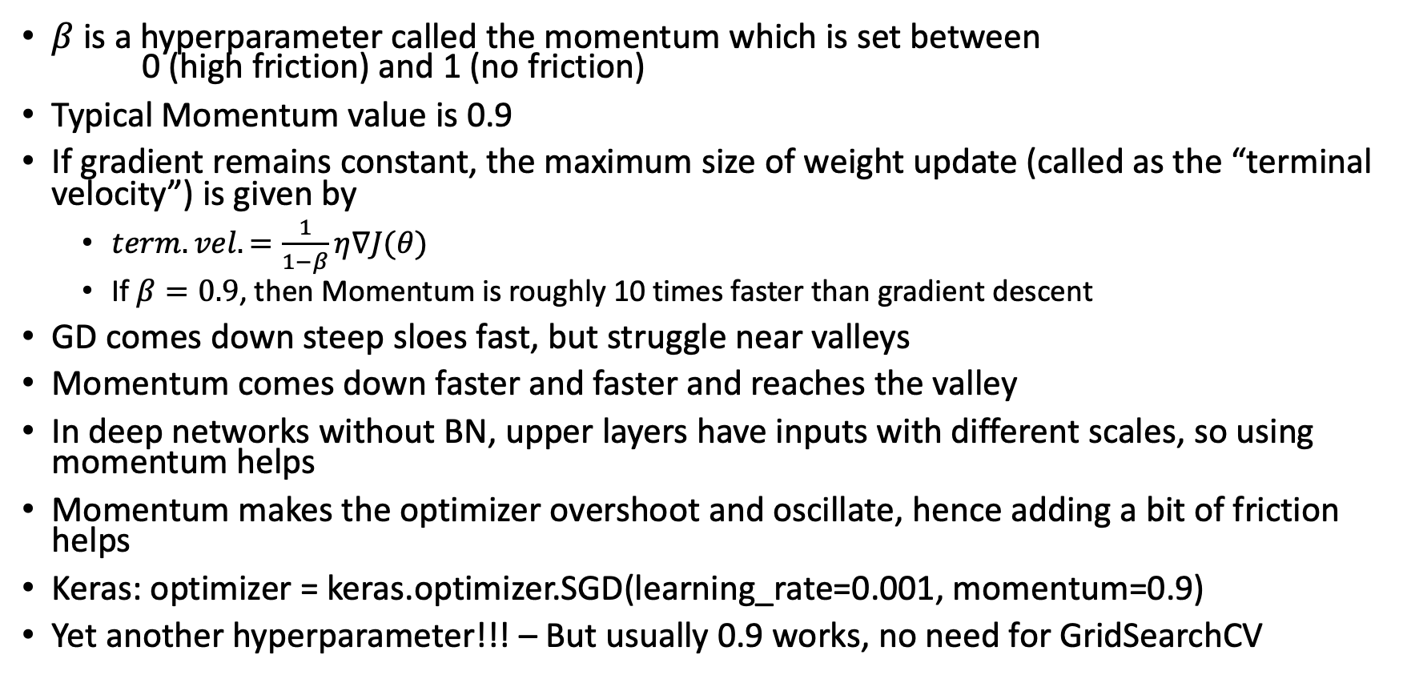
Momentum: Points to Note
$β$ is a hyperparameter called the momentum which is set between 0 (high friction) and 1 (no friction)
Typical Momentum value is 0.9
If gradient remains constant, the maximum size of weight update (called as the “terminal velocity”) is given by
$term. vel. =\frac{1}{1−β}η∇J(θ)$
If $β=0.9$, then Momentum is roughly 10 times faster than gradient descent
GD comes down steep sloes fast, but struggle near valleys
Momentum comes down faster and faster and reaches the valley
In deep networks without BN, upper layers have inputs with different scales, so using momentum helps
Momentum makes the optimizer overshoot and oscillate, hence adding a bit of friction helps
Keras: optimizer = keras.optimizer.SGD(learning_rate=0.001, momentum=0.9)
Yet another hyperparameter!!! – But usually 0.9 works, no need for GridSearchCV

Slide 35
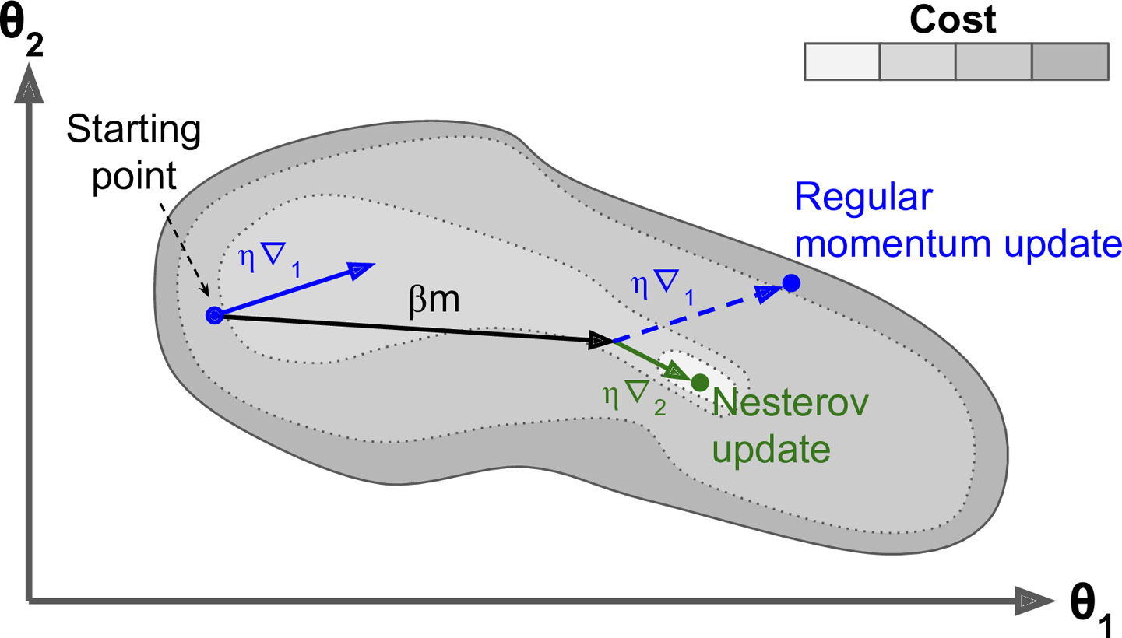
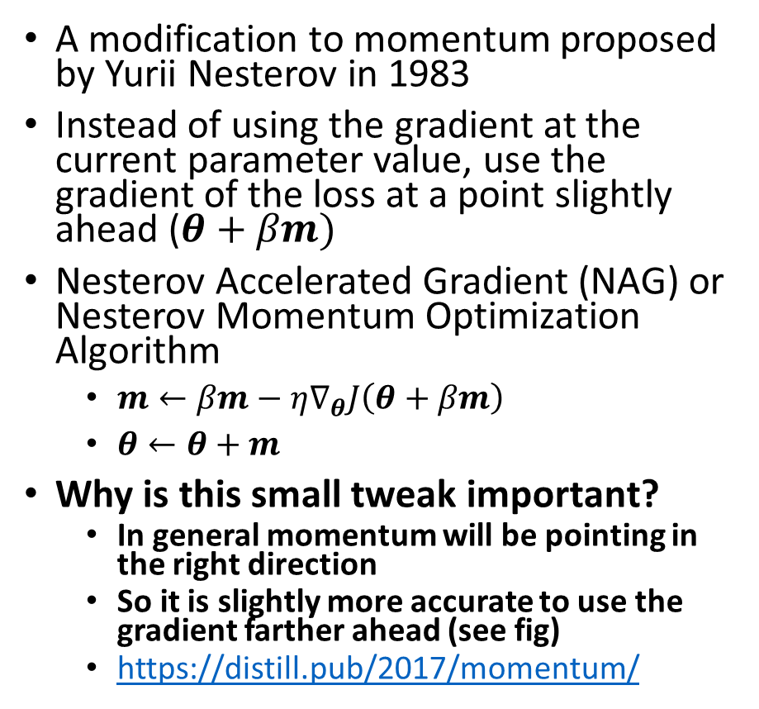
Nesterov Accelerated Gradient
A modification to momentum proposed by Yurii Nesterov in 1983
Instead of using the gradient at the current parameter value, use the gradient of the loss at a point slightly ahead ($θ+βm)$
Nesterov Accelerated Gradient (NAG) or Nesterov Momentum Optimization Algorithm
$m←βm−η∇_{θ}J\left(θ+βm\right)$
$θ←θ+m$
Why is this small tweak important?
In general momentum will be pointing in the right direction
So it is slightly more accurate to use the gradient farther ahead (see fig)
https://distill.pub/2017/momentum/
[Geron Fig 11-6]

Slide 36
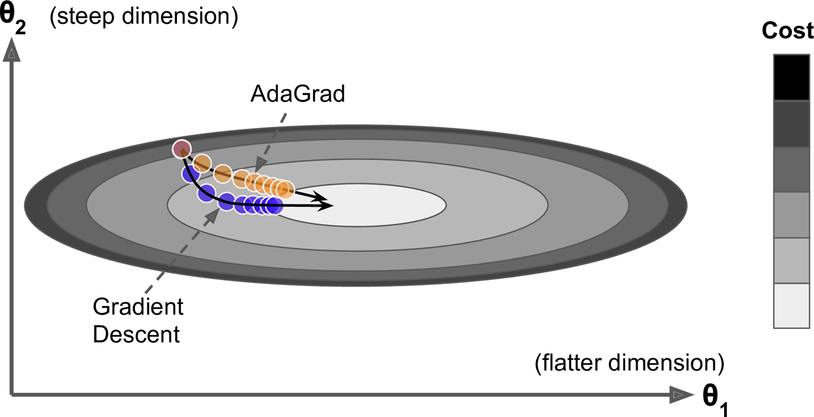

AdaGrad
In objective functions that have an elongated bowl shape
One axis is a flatter dimension, and another is a steep dimension
GD will be more inclined to move in the steeper dimension
AdaGrad modifies the gradient by scaling down the vector along the steepest dimensions
AdaGrad Algorithm:
$s←s+∇_{θ}J\left(θ\right)⨂∇_{θ}J\left(θ\right)$ [element-wise mul]
$θ←θ−η∇_{θ}J\left(θ\right)⊘\sqrt{s+ε}$ [element-wise div]
In effect, the algorithm itself changes the learning rate per dimension
Hence it is an adaptive learning rate algorithm
AdaGrad is not used in practice as it stops too early while training neural networks
But AdaGrad idea is useful to understand other adaptive learning rate optimizers
Adagrad corrects its direction earlier than GD for this bowl shaped function
Geron Fig 11-7

Slide 37

RMSProp
RMSProp fixes the risk of early slowing down showed by AdaGrad
RMSProp accumulates gradients of only the most recent iterations using an exponential decay mechanism
RMSProp Algorithm
$s←ρs+(1−ρ)∇_{θ}J\left(θ\right)⨂∇_{θ}J\left(θ\right)$ [element-wise mul]
$θ←θ−η∇_{θ}J\left(θ\right)⊘\sqrt{s+ε}$ [element-wise div]
The decay rate $ρ$ is usually set to 0.9, and usually doesn’t need tuning
Keras: optimizer = keras.optimizer.RMSprop(learning_rate=0.01, rho=0.9)
Trivia: RMSProp was never published. Hinton introduced it in his Coursera class on Neural Networks. So citation is done as “slide 29 in lecture 6”!!!
RMSProp was the go to algorithm before Adam

Slide 38

RMSProp in Action
Green – RMSProp
Purple – Momentum

Slide 39
Poll
Which Algorithms uses adaptive learning rates?
RMSProp
Momentum
Nesterov
SGD
Which of the following is TRUE?
Momentum accelerated algorithm converges slower than SGD
Adaptive Learning rate helps to converge faster
RMSProp uses momentum
AdaGrad uses momentum

Slide 40

Adam
Adam stands for adaptive moment estimation
It gets the speed from momentum and ability to adapt learning rate in different dimensions from RMSProp
It keeps track of exponentially decaying average of past gradients – Momentum
It keeps track of an exponentially decaying average of past squared gradients (second moment) – RMSProp
Adam Algorithm:
$m←β_{1}m−\left(1−β_{1}\right)∇_{θ}J\left(θ\right)$
$s←β_{2}s+\left(1−β_{2}\right)∇_{θ}J\left(θ\right)⊗∇_{θ}J\left(θ\right)$
$\hat{m}←\frac{m}{1−β_{1}^{t}}$
$\hat{s}←\frac{s}{1−β_{2}^{t}}$
$θ←θ+η\hat{m}⊘\sqrt{\hat{s}+ε}$
$β_{1},β_{2}$ are hyperparameters between 0 and 1. Usually $β_{1}=0.9, β_{2}=0.99$
$ε={10}^{−7}$ a smoothing term to avoid division by zero
$t$ is the iteration count. Steps 3,4 are needed as $m,s$ are initialized to zero and initially a boost is needed

Slide 41

Adam
Adam is an adaptive learning rate algorithm
It requires less tuning of $η$
The default value can be used directly
Keras: optimizer = tf.keras.optimizers.Adam(learning_rate=0.001, beta_1=0.9, beta_2=0.999, epsilon=1e-07, amsgrad=False, name='Adam’)
Amsgrad: Whether the AMSGRad version of Reddi et al 2018 is used (https://openreview.net/pdf?id=ryQu7f-RZ)

Slide 42

Variants of Adam
AdaMax
Replace step 2 with $s←\max\left(β_{2}s,∇_{θ}J(θ)\right)$
Adam scales down the parameter update by the $l_{2}$ norm, AdaMax does it by the $l_{∞}$ norm
In theory, AdaMax is more stable, but in practice it depends on the dataset
Usuaully Adam wins, but if Adam has some problem on a particular task you are dealing with, then AdaMax helps
Nadam
Adam with Nesterov trick
But in most situations, Adam or RMSProp works well, Nadam is not needed
AdamW
Adam with a weight decay
When l2 regularization is used, AdamW is found to be better than Adam with l2 regularization
For image classification and character RNN tasks, AdamW generally has a slight edge
But even for these, SGD+Momentum gives better generalization empirically
See the paper: https://arxiv.org/pdf/1711.05101.pdf

Slide 43
Word of Caution
Adaptive optimization methods are great, but they can overfit and give poor generalization in some datasets
If you are in such a situation, keep this caution in mind and try NAG as well

Slide 44

Summary
[Geron 2nd Edition 2019]

Slide 45



Learning Rate Scheduling
Too low LR will eventually converge but it will be slow
Too high LR will diverge
Using learning rate scheduling will help
High Learning Rate
Low Learning Rate

Slide 46

Scheduling Options
Power scheduling
$η\left(t\right)=\frac{η_{0}}{{\left(1+\frac{t}{s}\right)}^{c}}$ $t$ is the iteration count, $s$ is the number of steps after it $η$ becomes half
Exponential scheduling
$η\left(t\right)=η_{0}{0.1}^{t/s}$
Piecewise constant scheduling
Use a constant learning rate of a number of epochs
Performance scheduling
Measure the validation error every N steps and reduce the learning rate by a factor
1cycle scheduling
Start by increasing learning rate from $η_{0}$ to $η_{1}$ linearly and then reduce to $η_{0}$ linearly
Maximum learning rate is chosen by finding the optimal learning rate and using initial rate as 1/10
Momentum can also be subject to 1cycle scheduling
Smith 2018 showed that 1cycle scheduling achieved as much accuracy after 100 epochs as with 800 through standard approach [arXiv:1803.09820]

Slide 47
Learning Rate Scheduling
Exponential scheduling and performance scheduling work very well
1cycle works even better and one can use one of the three options well
Power scheduling is easiest to implement in Keras
Keras: optimizer = keras.optimizer.SGD(learning_rate = 0.01, decay = 1e-4)
Others have to be implemented via callbacks

Slide 48

Regularization
Neural Networks are prone to overfitting
They have tens of thousands (even millions in some networks) of parameters
The flexibility to fit complex datasets comes with the disadvantage that they can overfit
Three popular regularization techniques are used:
$ℓ_{1}$ and $ℓ_{2}$ regularization
Set kernel_regularizer and specify the l1 or l2 factors
Dropout
At every training step, each neuron has a probability $p$ (called dropout rate) of being temporarily “dropped out”
After training, neurons don’t get dropped any further
Max-norm regularization
Scale weights if their norm exceeds a max norm

Slide 49

Dropout Regularization: Points
Neurons trained with dropout cannot rely on specific other neurons, they have to learn to be useful even when others are not present
So they tens to become less sensitive to slight changes in the input and so generalize well
Another view is that is a Neural Network has n paraemters there are virtually $2^{n}$ different options for some neurons to be active and others to be inactive
So when 10,000 training steps are run, it is like there are 10,000 networks
The analogy is not perfect, but it is approximately true
In practice, dropout is applied to the top 1 to 3 layers – empirically this is found to work well
Important technical detail
Suppose p=0.5, then during training only half the neurons are active
Consider one neuron, during training only 50% of its inputs are active
But during testing, all are active! Roughly the input will now be 2x
So we must multiply all weights with (1-p) after training, or divide weights by (1-p) during training
Dropout makes comparing training and validation loss tricky. Make sure to evaluate without dropout (after training of course)
Alpha dropout is needed if you use SELU

Slide 50


Summary and Practical Guidelines
Normalize Inputs
Get good data, use unsupervised pretraining, reuse layers
Have Fun!!!

